Slide 1
SHAC Celebrates!
FBISD General SHAC Meeting
WEDNESDAY, MAY 15, 2024

Slide 2
Welcome & Mindful Moment
Allison Thummel
Fort Bend ISD SHAC Chair

Slide 3
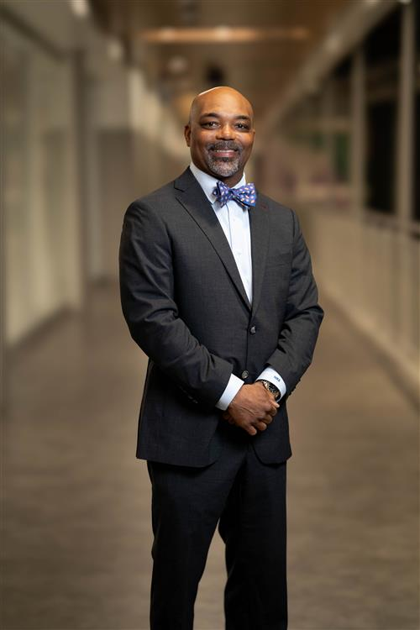
Dr. Marc Smith

Slide 4
SHAC Recognitions
Allison Thummel
FBISD SHAC Chair

Slide 5
SHAC outgoing executive team
Parent Chair: Allison Thummel
Co-Vice-Chair: Dana Tran
Co-Vice-Chair: Catalina Flores-Rau
Secretary: Jenna Ross
Ex Officio Chair: Melanie Anbarci
Membership: Jigisha Doshi

Slide 6
SHAC incoming executive team
Parent Chair: Catalina Flores-Rau
Vice-Chair: Nicole Juracek
Secretary: Derek Craig
Membership: Jigisha Doshi
Ex Officio Chair: Allison Thummel

Slide 7
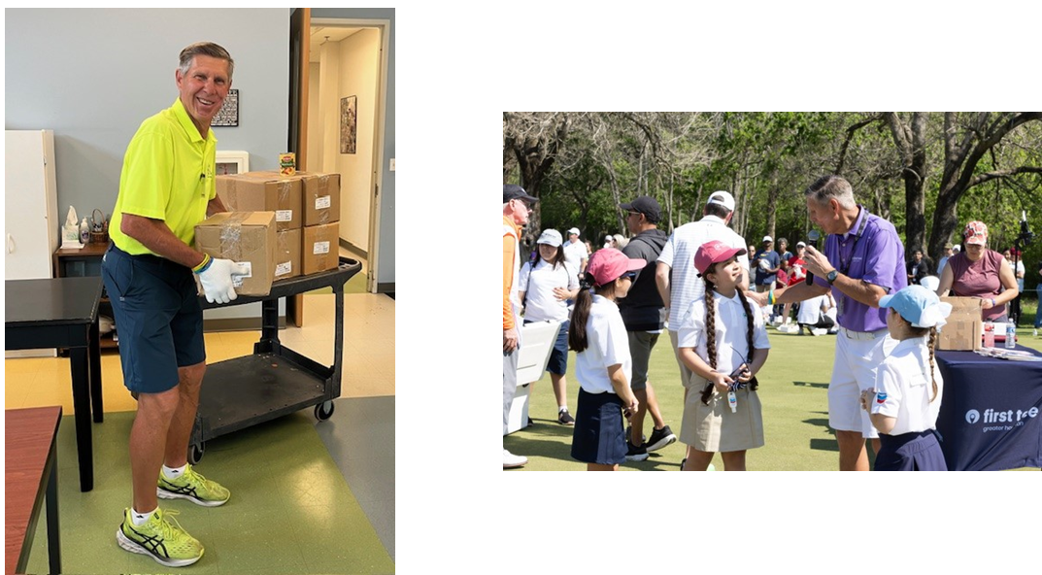
FBISD CELEBRATES PUBLIC SCHOOL VOLUNTEER WEEK,COMMUNITY MEMBER DOUG EARLE
& 10+ Years with SHAC!!!

Slide 8
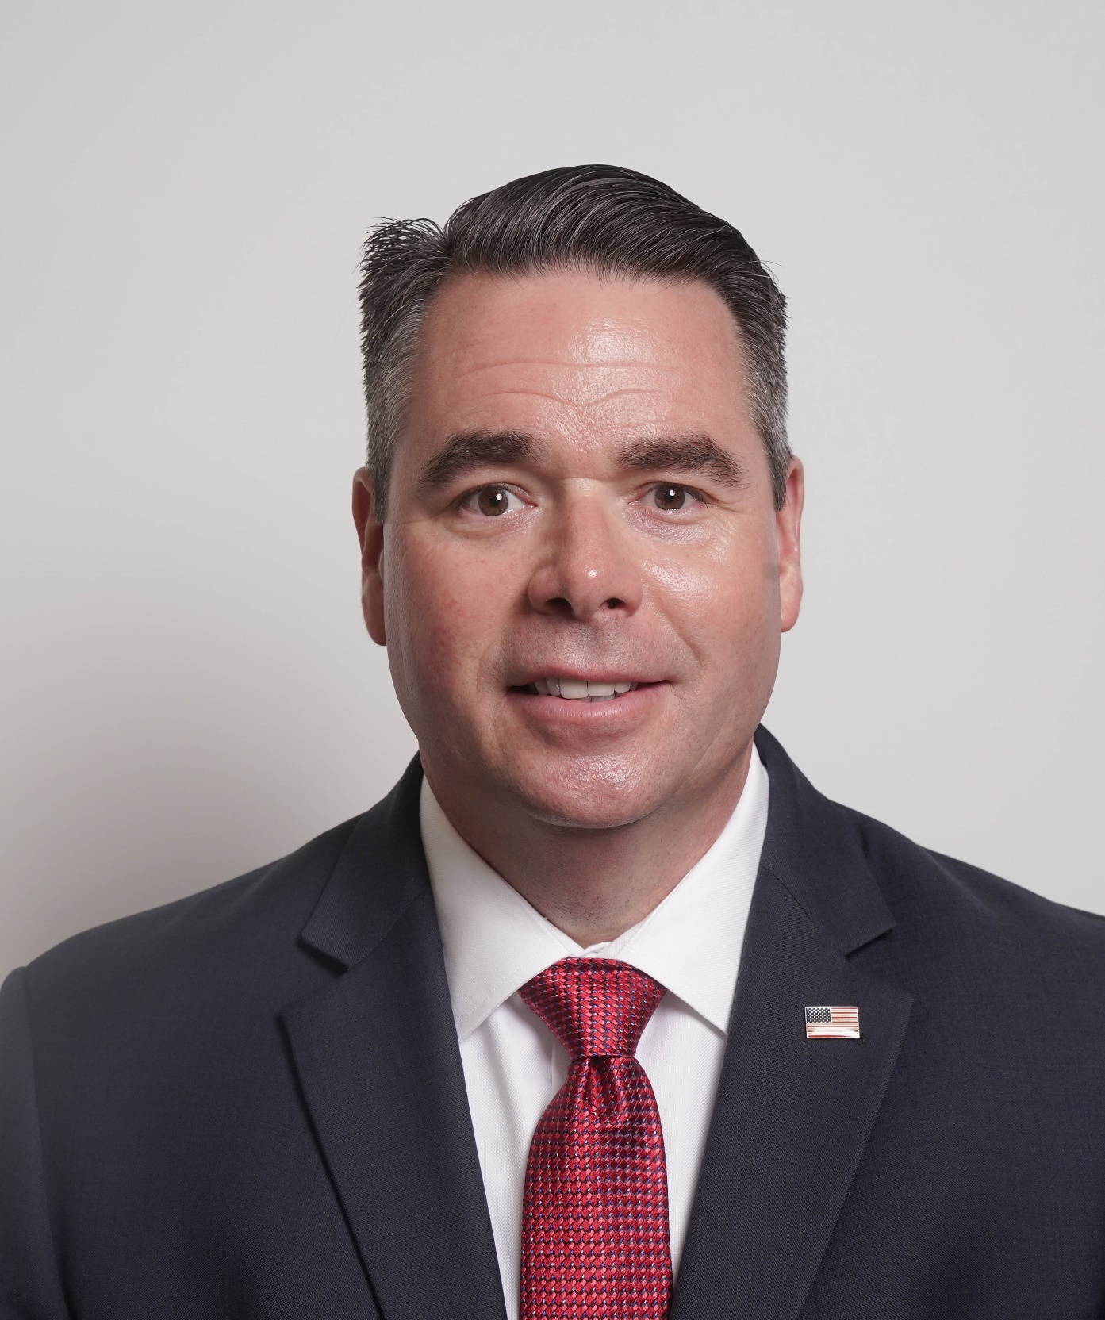
SHAC Subcommittee leads:
Advocacy: Chassidy Olainu-Alade
Campus Wellness Committees: LaDonna Green
Health & Safety: Bart Rosebure
Nutrition: Susan Nayeri
PE/Physical Activity: Kim Taylor
Student Wellness Committees: Angela “Espi” Espinosa
Whole Child Health: Lori Sartain

Slide 9
District Student Wellness Coalition Recognition
Angela Espinosa
FBISD Social and Emotional Learning Coordinator

Slide 10
Austin HS:
Ameya Apte
Eeshal Noorani
Vani Patel
Bush HS:
Jamesha Powell
Chidera Oforkansi
Deshaina Griffin
Clements HS:
Andrew Ross
Elkins HS:
Adrian Thummel
Emmi Tran
District Student Wellness COALITION
Recognition
Dulles HS:
Vritti Divecha
Josslyn Reyes
Sraavani Poluri
Hightower HS:
Naomi Kurian
Allison Nguyen
Paresh Chotaliya
Christian Jones
Kempner HS:
Anghela Quispe
Kristine Recio
Liana Tang
Marshall HS:
Abigail Gutierrez
Haniyah Syed
Praise Amzat
Founding members
2023 - 2024
Ridge Point HS:
Wynston Rodriguez
Rebecca Mathew
Willowridge HS:
Yaretzi Corona
Clyde Wilson
Travis HS:
Zia Maredia
Maahi Board
Arianna Medina

Slide 11
FBISD SHAC Wellness Heroes
LaDonna Green
FBISD Wellness, Health & Prevention Specialist

Slide 12
Natalie Bostic, RN, James Reese CTE

Slide 13
Briana Garcia, FBISD Coordinator of Marketing Child Nutrition & SHAC Communications

Slide 14
Nicole Juracek, Neill PTO & Gardener Extraordinaire

Slide 15
Eric Sweeney, CHS Assistant Principal

Slide 16
Donna Whisonant, ASE Principal

Slide 17
23-24 PRIDE Survey Highlights
Kim Taylor
FBISD Coordinator of Health, PE & Wellness

Slide 18
PRIDE Survey in Fort Bend ISD 2023-24
Notes:
HI my name is kim Taylor, I am the coordinator of health, pe and wellness. One initiative that I support is the PRIDE survey. This survey is used to gather information on our students’ use and perceptions around risky behaviors such as drugs and violence. We do this survey every 2 years and I would like to share some of the information with you today. Keep in mind that I will be sharing some of the general trends from the data. We will not have time to dive into the why or draw conclusions.

Slide 19
Survey Description
A collaboration between FBISD and FBCPC (a program of FBRC)
7th, 9th and 11th graders – 100 students for each grade level
25-30 minutes to complete
This administration was completed online.
Survey is anonymous. Students may decline to participate, although very few ever do.
Students surveyed: 3419
Notes:
This survey is a collaboration between fbisd and fbcpc- fort bend community prevention coalition. . We survey 100 students from 7th, 9th and 11th grades. It takes about 25 -30 minutes for students to complete. we used an online administration. The survey is completely anonymous and voluntary. This year we surveyed a total of 3871 students.

Slide 20
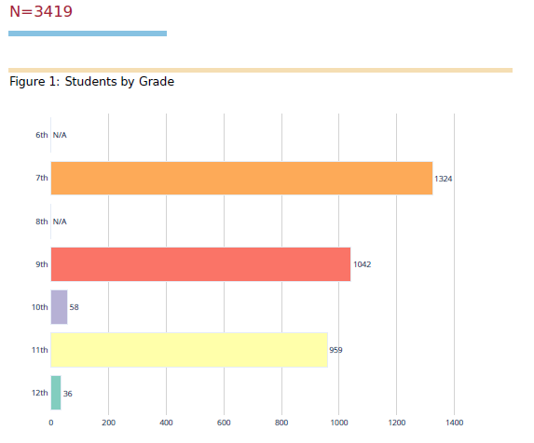
N/A
N/A
Notes:
We use the middle school health classes to survey 7th graders and social studies classes in high school.Teachers are asked to provide a sample of 100 students that are 50/50 males and females and include students from GT classes.
In high school, we survey social studies classes to survey 9th and 11th graders with the same parameters that we use for 7th grade. The teachers were trained on the use of the online survey.
These are our totals by grade level.. 7th grade numbers are higher because we have more middle school campuses.

Slide 21
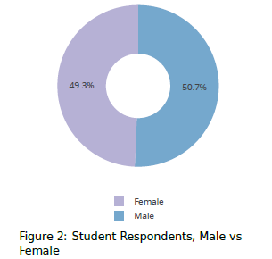
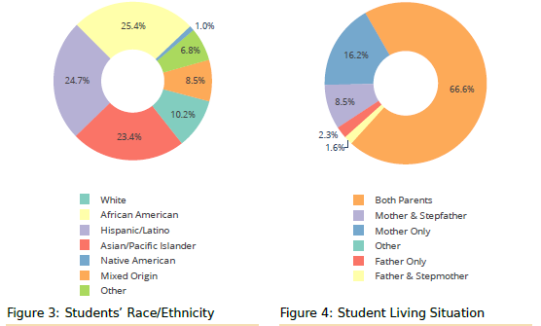
Student Demographics

Slide 22
Some Cautions:
Self-report
Online survey presented some challenges
Results vary in sync with national results, suggesting that students were honest in responding
NOT a scientifically selected sample – we use what is known as a “convenience sample”
Remember there is error in all surveys
Although data was collected at schools, problems with substance abuse are actually community-based.
Notes:
There are always cautions and considerations when doing student surveys.

Slide 23
Some General Trends
Notes:
Today I will share some general trends that can be seen with the data. There are many different factors that we could dive into, but today we will look at the big ideas. I do want to share that each campus also gets its own data and uses it to create goals for their campus. The data I am sharing today is the overall district data.

Slide 24
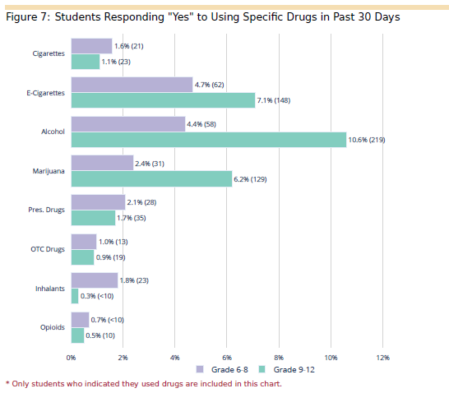

Slide 25
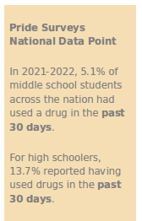
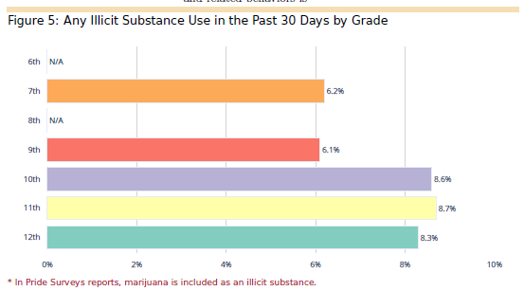
N/A
N/A
Notes:
This slide shows the use of any illicit substance in the last 30 days. As noted at the bottom, marijuana is included in these numbers. The percent of use increases in 11th grade. The number of 7th graders is higher than the national numbers, But, our high school students report using less than the national average.

Slide 26
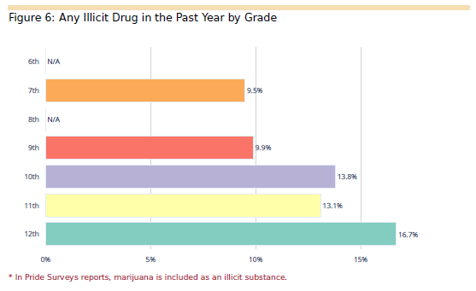
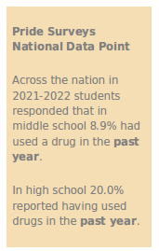
N/A
N/A
Notes:
Again our middle school number has jumped over the national average, but our high school numbers are lower.

Slide 27
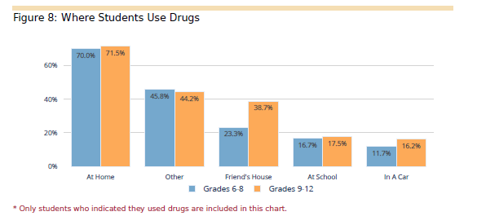
Notes:
The survey looks at where students use substances. Most students that use drugs report using it at home. Notice that at school is the second lowest reported place of use, just above in a car.

Slide 28
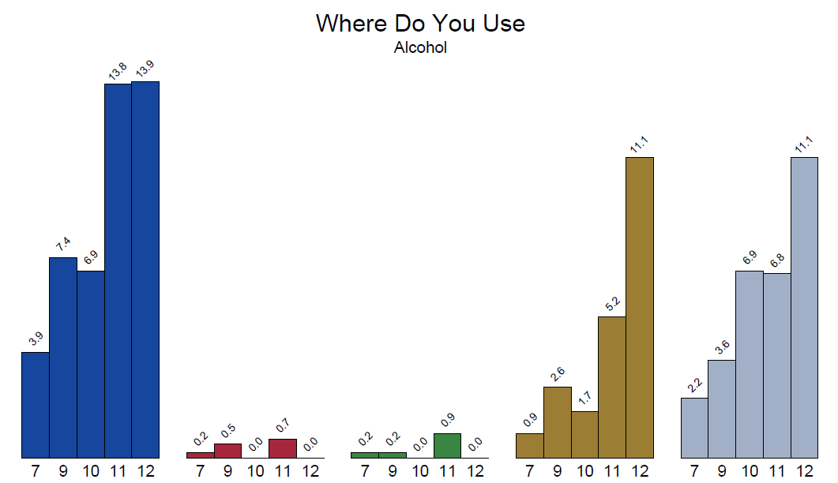
Notes:
If we break it down by substance, we can look at alcohol. Most students that use alcohol report using it at home. Notice that school is the lowest reported place of use

Slide 29
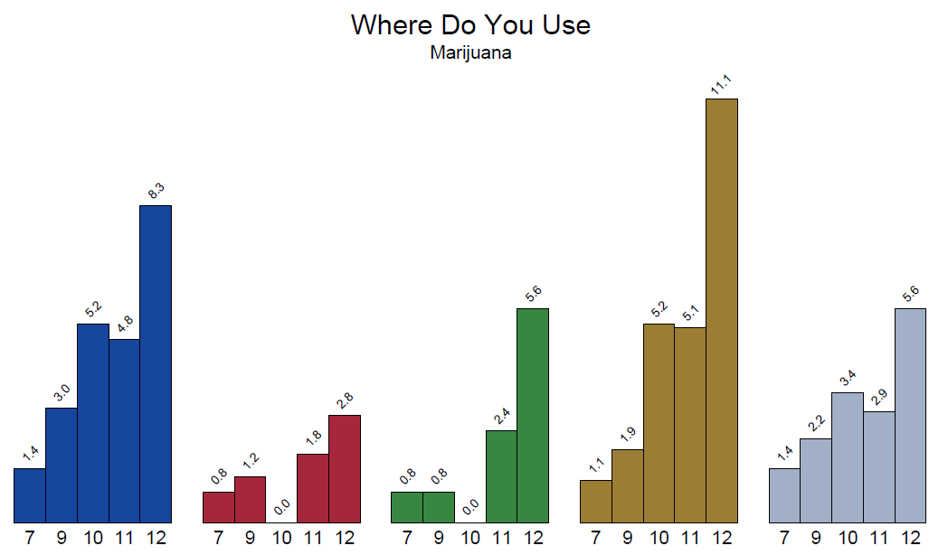
Notes:
For marijuana, home and a friend’s house are the top places that students report using. Again, school is the one of the lowest.

Slide 30
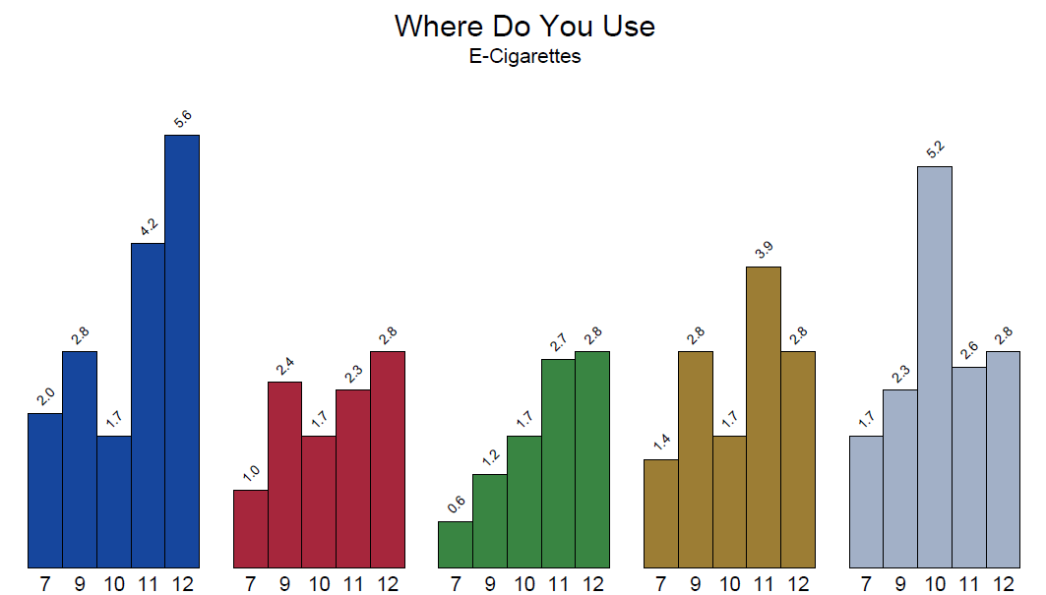
Notes:
E-cigarette numbers start to even out across locations. We believe this to be due to the ease of which it is to hide e- cigarettes/vapes and take them to many locations.

Slide 31
SUBSTANCE USE TRENDS OVER TIME
Notes:
The PRIDE survey allows us to track trends over time. We will take a look at the trends since 2015.

Slide 32
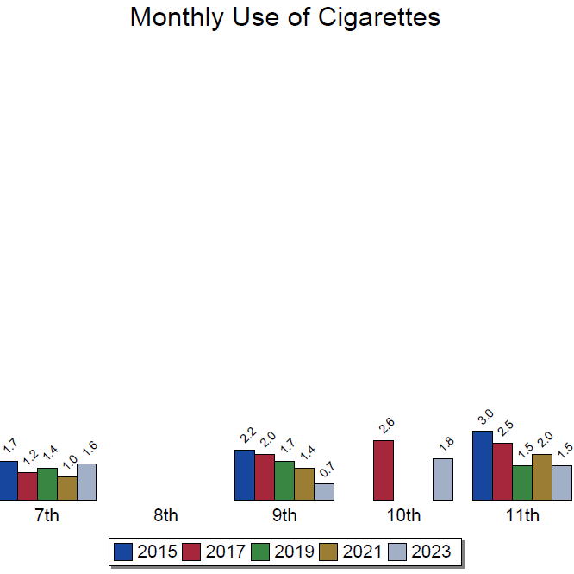
Notes:
These next few graphs will let us look at data from our surveys in 2015, 17, 19, 21 and 23.
If we look at the monthly use of cigarettes through the years, we had a slight bump in our 7th graders, but our high school students are using less than before.

Slide 33
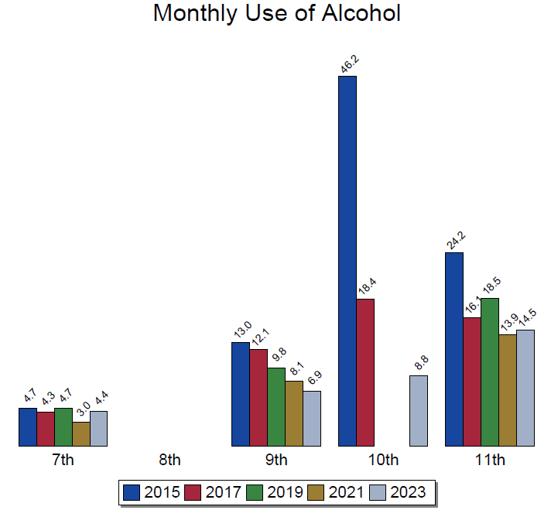
Notes:
Looking back to 2015, monthly alcohol use increased slightly in our 7th and 11th graders since 2021, but there has been a general decline since 2015.

Slide 34
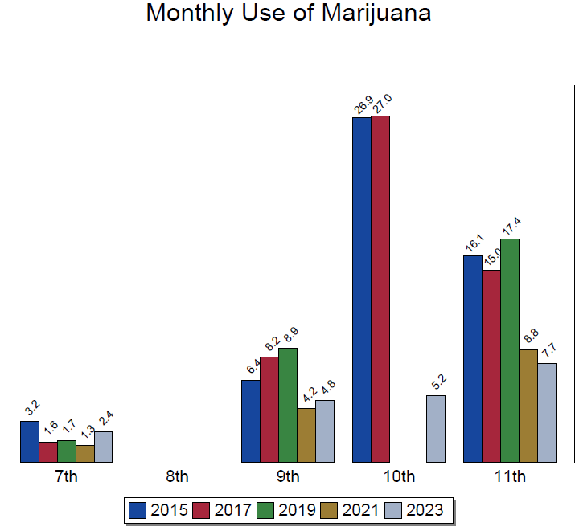
Notes:
Similarly, marijuana is still on a general decline since 2015, with a noted increase in our 7th and 9th graders since the last survey. This will be interesting data to continue to follow. There are many factors that might be contributing to these small increases.

Slide 35
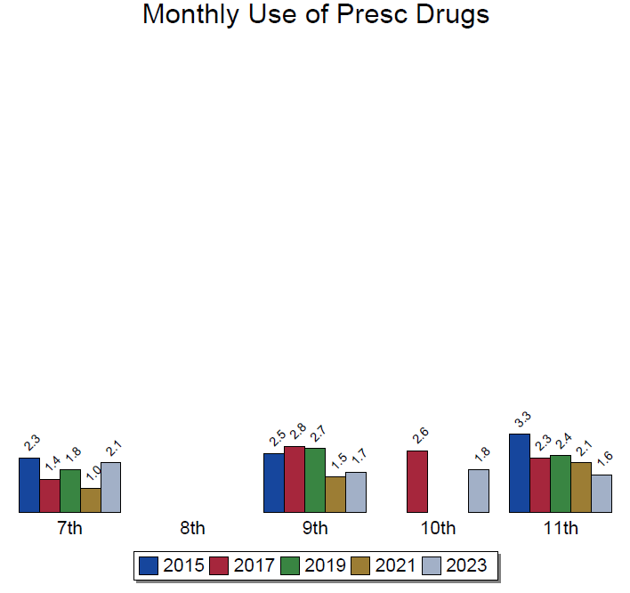
Notes:
Middle school students also show an increase for monthly use of prescription drugs. When we look at all of the monthly use data, it is notable that reported use for all of the substances increased in our middle school students.

Slide 36
Perception of Risk
Notes:
Perception of risk can give us some insight into the motivation for drug use

Slide 37
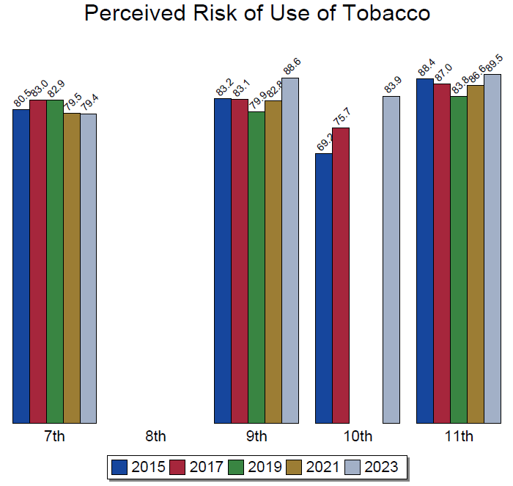
Notes:
Overall perception of risk for tobacco is increasing. This is true for all substances we looked at. This could be due to many factors, hopefully including our prevention efforts from the district.

Slide 38
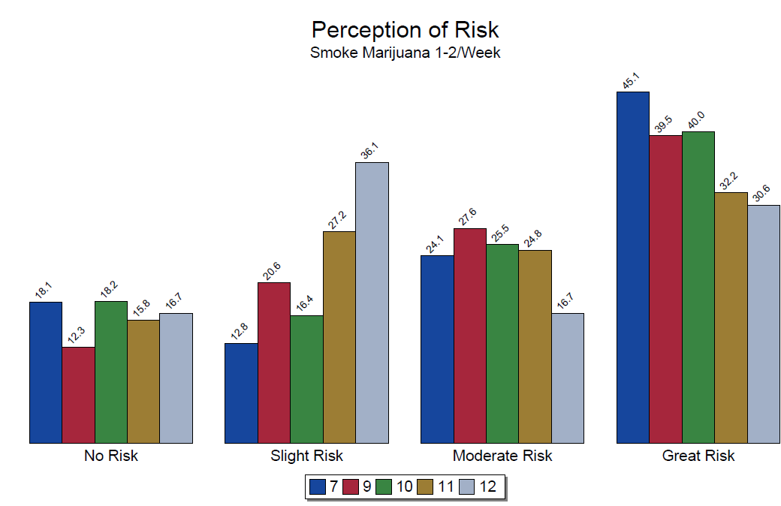
Notes:
It is interesting to note though, that as students get older, the perceived risk (looking at moderate to great risk) of marijuana use goes down. This could be due to factors including the legalization in other states, as well as parent perceptions. Additionally, media influences might affect this data

Slide 39
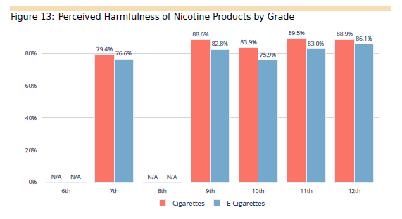
Notes:
Student are still perceiving e- cigarettes to be less harmful than cigarettes. We need to continue efforts to educate our youth on the dangers of these products

Slide 40
Differences by Gender

Slide 41
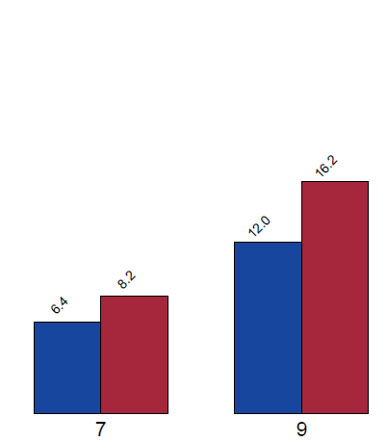
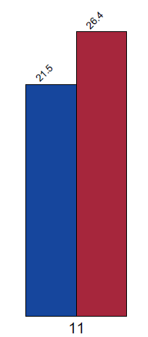
Notes:
As I click through the next 3 slides, you will see that the red bar consistently higher. This is showing that for each substance females report higher annual use. This is true for almost all of the substances. We noticed this in our last survey as well.

Slide 42
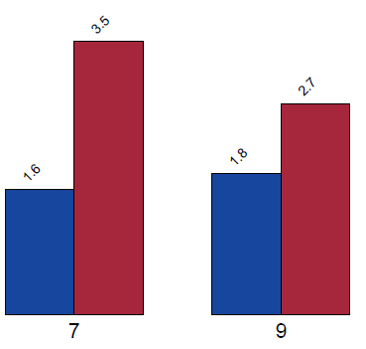

Slide 43
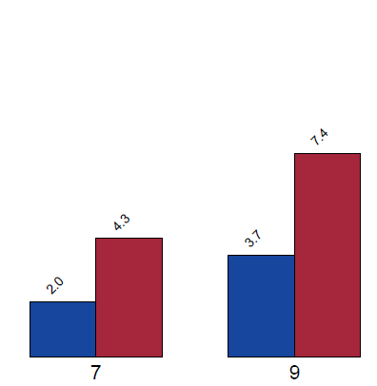
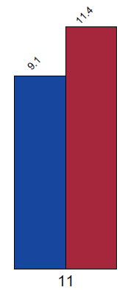

Slide 44
Notes:
It is interesting to note that although females report using more than males, they seem to have a higher perception of risk. This creates questions around what motivates the females to use substances since the perception of risk is not deterring them.

Slide 45
Suicidal Thoughts

Slide 46
Notes:
When high school students were asked if they had thoughts of suicide, the numbers have stayed about the same since our last survey administration. Numbers are lower from 2018, but higher then 2020. there are some theories that the increase in 2020 was covid related. Of course, all concerns around suicide should be addressed.

Slide 47
Notes:
Middle school student responses have increased a little this year. This indicates a need for continued efforts around mental health

Slide 48
Feeling Safe at School?

Slide 49
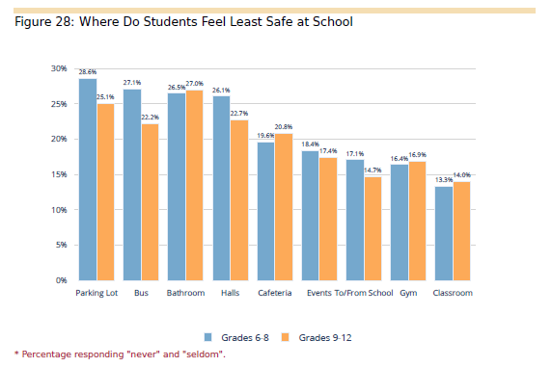
Notes:
Looking at where students feel safe can give campuses good information about the feeling of of overall safety. Bathrooms, buses, hallways and parking lots continue to be areas of most concern for students. When campuses get their own data, this is something they can work to improve.

Slide 50
Notes:
We know that cyberbullying is potential problem. This seems to be a bigger concern for middle schoolers than it is for high schoolers. Including data from 1 time to 6 or more times-21.6% of middle schoolers report being embarassed or threatened on internet or cell phone, For high school, it is 14%. These numbers indicate a need for continued efforts to discourage cyberbullying.

Slide 51
Mental Health Supports on Campus

Slide 52
Notes:
Promising data – Approximately 70% of our students feel safe speaking to an adult on campus about mental health issues. Additionally, about 59% feel that it is easy to access mental health supports. This is good news. However, 25% of students report being unaware of any supports on their campus. This suggests that we need to continue our efforts to bring awareness to these programs.

Slide 53
Thank you!
Notes:
. Thank you. As a reminder, each campus gets their campus specific data in order to address concerns on their campus.

Slide 54
Celebrations of SHAC Subcommittees
Allison Thummel
FBISD SHAC Chair

Slide 55
100% Campus Participation
72% Campuses Wellness Committees with Wellness CIP Strategies

Slide 57
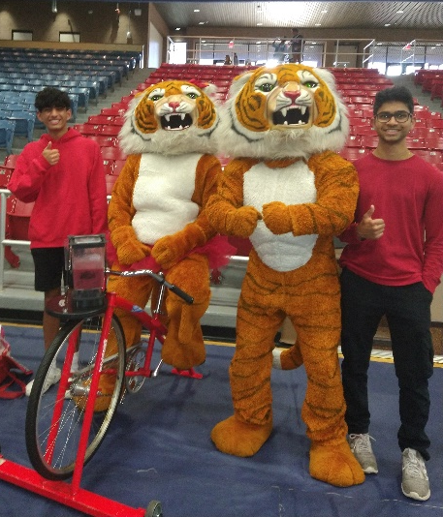
STUDENT WELLNESS COMMITTEES Inaugural Year
Think Tank Competition
Whole Child Health Fair

Slide 58
ADVOCACY
SHAC Legislative Priorities: Approved
Civic Engagement Presentation to SHAC
Sugar Land Intergovernmental Relations: presentation by Rick Ramirez, Intergovernmental Relations Manager at City of Sugar Land
Student Voter Registration Drives

Slide 59
WHOLE CHILD HEALTH
Fentanyl Poisoning Awareness Curriculum: SHAC Approved
Whole Child Health Parent & Student Webinars: 6
Shared Dreams: 35th anniversary (SHAC Food Drive)
Social Work Holiday Spread Cheer To Families: 302 (Thanksgiving) & 250 (Christmas)
See to Succeed: 350+ students free eye exams & glasses if needed
Project Saving Smiles: 448 students given free dental exams
Title I campuses school supplies: 16,000 students

Slide 60
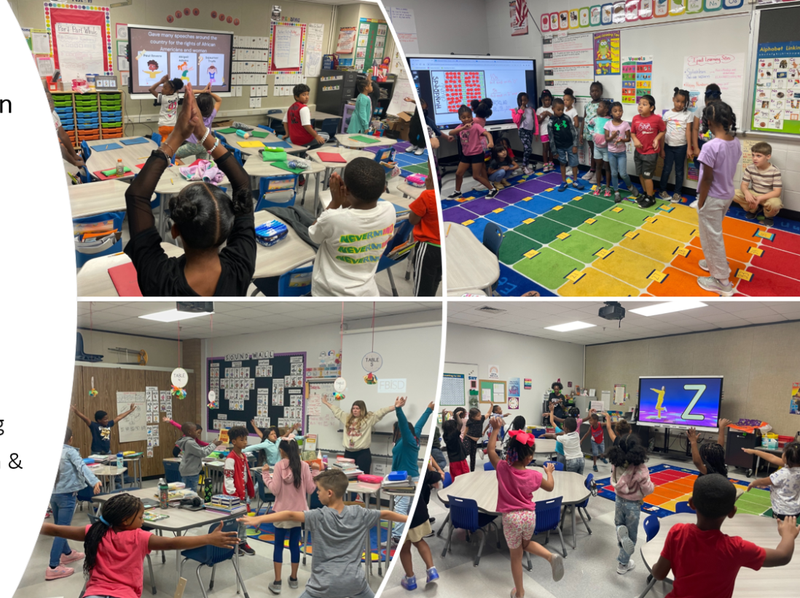
PHYSICAL EDUCATION/ PHYSICAL ACTIVITY
Action Based Learning (ABL) labs: 7 campuses
National Walk to School Day (Oct) & Bike to School Day (May)

Slide 61
Brain Break
Courtney Skiles
FBISD Health & Engagement Coordinator

Slide 62
BRAIN BREAK
THIS OR THAT!
Courtney Skiles
Health and Engagement Coordinator
Notes:
Hello and welcome to our Everyday Mindfulness presentation, brought to you by UnitedHealthcare.
My name is ______________________ and I am a Health Engagement (Consultant, Nurse, Coach or Coordinator) with UnitedHealthcare.

Slide 63
Stand up for the Beach
Arm Swings for the River

Slide 64
Hands up for Watermelon
Touch the ground for Strawberries

Slide 65
Jumping Jacks for Ice Cream
Squats for Popsicles

Slide 66
High Five your neighbor for Summer Vacation!

Slide 67
BOT Summary
Allison Thummel
FBISD SHAC Chair

Slide 68
SHAC as a Resource
Support Campuses
Help schools meet community involvement mandates and community expectations
Encourage Collaboration
Provide a way for parents and community members to work together with school personnel to accomplish district goals, utilize community resources and assets
Build Capacity
Educate community members to be a credible, collective voice for healthy children and youth
Provide Health, Wellness, & Safety Resources
Provide a forum for sharing youth health information, resources, perspectives and a range of advice
Notes:
Presenter: Allison
Time: 30 seconds
Say: In the 2023-2024 school year, SHAC has been a resource for the school district in the following ways:
Supporting the campuses.
Encouraging collaborations
Building capacity
Providing health, wellness and safety resources

Slide 69
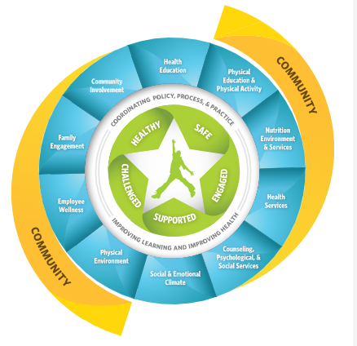
SHAC Subcommittees
Physical Education & Physical Activity
Whole Child Health
Campus Wellness Committees
Nutrition
Advocacy
Campus
Safety
Notes:
Presenter: Allison
Time: 30 seconds
Say: SHAC consists of 6 subcommittees consisting of these.
Each subcommittee was led by an FBISD employee and tried to include at least 1 parent.
Each subcommittee established goals that it tried to work on during the year.

Slide 70
SHAC Goals
SHAC Legislative Priorities
Student Wellness Committees
Campus Improvement Plans Re: Wellness
Increase support and awareness of Student Wellness Committees & recognition of their sponsors
Ensure Campus Improvement Plans include wellness strategies created by their Campus Wellness Committee
Develop a process for SHAC to provide input on Board adopted Legislative Priorities
Action Based Learning
Gun Safety & Storage
Mental Health Supports
Develop a process for the District to provide families with gun safety and storage information
Recommend expansion of Action Based Learning Labs and including movement in classrooms (all levels)
Expand District level mental health supports available to ALL students
Notes:
Presenter: Allison
Time: 3 minute
Say: These were the 6 goals that SHAC focused on in 2023-2024. (Elaborate)

Slide 71
SHAC Legislative Priorities
The FBISD SHAC Supports:
Measures encouraging physical fitness and Action Based Learning, including effective use of fitness assessments.
Funding for a multi-tiered system of mental and behavioral health support that fosters safe and healthy school environments for students, educators and staff.
Measures to ensure that all children receive access to healthy school meals, including breakfast and lunch to reduce food insecurity and hunger.
Notes:
Presenter: Allison
Time: 3 minute
Say: Our first goal during this school year was designing 6 Legislative Priorities, and SHAC has narrowed it down to these three. We hope that the BOT will take note of these LPs and possibly incorporate one or parts of these, into their BOT LP. These are the measures that we the SHAC support, and encourage individuals to advocate for. Reaching out to our representatives was encouraged to all the SHAC members and guests. Being involved in the legislative process is important.

Slide 72
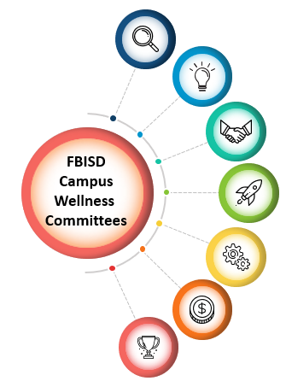
Mental Health Supports for Students & Staff
Whole Child Health Parent & Student Success Webinars
Promote Mental Health Supports
Provide Awareness of the District’s Multi-Tiered System of Support (MTSS)
Whole Child Health Campus Events & Initiatives
Notes:
Presenter: Allison
Time: 3 minute
Say: The last of our goals this year was to Expand District level mental health supports available to ALL students. We believe we still have room for improvement, and have elaborated on this goal for the upcoming school year, as you’ll see in a moment.

Slide 73
SHAC Accomplishments
Campus Wellness Committees
100% Participation
Student Wellness Committees & Sponsor Recognitions - 100% Participation
2nd Annual Think Tank
District Student Wellness Coalition: Inaugural year
72% of Campuses with Wellness CIP Strategies
Adoption of Fentanyl Poisoning Awareness Curriculum 2024
Process Developed for SHAC to Provide Legislative Priorities to Board of Trustees
Triennial Wellness Policy Review
Student Wellness Event (4/20/24)
Notes:
Presenter: Allison
Time: 3 minute
Say: These are accomplishments that the SHAC has accomplished, or is in the process of completing. (Elaborate.)

Slide 74
Think Tank
Student Wellness Committees (SWC) identified an issue/dilemma that their campus faces related to student mental, physical, or nutritional health.
SWC’s devised a solution to help address their campus’ issue.
Grant funds awarded from United HealthCare
$800
$1200
$500
Notes:
Presenter: Allison
Time: 30 seconds
Say: This was our 2nd year to host the FBISD SHAC/United HealthCare Think Tank. Student Wellness Committees (SWC) identified an issue/dilemma that their campus faces related to student mental, physical, or nutritional health. SWC’s devised a solution to help address their campus’ issue. Grant funds awarded from United HealthCare were 1200, 800 and 500 dollars. We want to thank UHC for this generous donation for our students and their campus projects.

Slide 75
SHAC Recommendations for 2024-2025
Increase awareness and actionability of Student Wellness Committees and recognition of their sponsors
Develop a process for the District to provide families with gun safety and storage information
03
Recommend and explore Best Practices for cell phone use on campuses
03
Recommend expansion of Action Based Learning Labs and including movement in classrooms (all levels).
Evaluate the feasibility of high school starting later
Expand District-level mental health supports available to ALL students and evaluate and improve the effective and time-sensitive access of Multi-Tiered System of Support
02
04
Ensure Campus Improvement Plans include wellness strategies created by their Campus Wellness Committee
01
05
Notes:
Presenter: Allison
Time: 3 minute
Say: Moving forward, the SHAC has the following recommendations for the 2024-2025 school year. (Elaborate).

Slide 76
Wellness Policy Vote
Jenna Ross
Fort Bend ISD SHAC Secretary

Slide 77
Vote
SHAC Meeting Minutes
April 10, 2024
Jenna Ross
Fort Bend ISD SHAC Secretary

Slide 78
Meeting Dates for 2024-25 School Year
Catalina Flores-Rau
Incoming FBISD SHAC Chair

Slide 79
DATE | DAY | LOCATION | TIME
September 4th, 2024 | Wednesday | Fort Bend ISD Administration Building – Board Room | 12:00 pm – 1:30 pm
October 16th, 2024 | Wednesday | Fort Bend ISD Administration Building – Board Room | 12:00 pm – 2:00 pm
December 4th, 2024 | Wednesday | Fort Bend ISD Administration Building – Board Room | 12:00 pm – 2:00 pm
February 19th, 2025 | Wednesday | Fort Bend ISD Administration Building – Board Room | 12:00 pm – 2:00 pm
April 9th, 2025 | Wednesday | Fort Bend ISD Administration Building – Board Room | 12:00 pm – 2:00 pm
May 14th, 2025 | Wednesday | Fort Bend ISD Administration Building – Board Room | 12:00 pm – 2:00 pm
Subhead
FBISD School Health Advisory Council Meeting Schedule
2024 - 2025

Slide 80
Upcoming Events
LaDonna Green
Fort Bend ISD Wellness Health & Prevention Specialist

Slide 81
May Events
May is Mental Health Awareness Month.

Slide 82
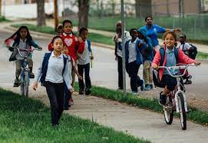
Subhead
Walk or Bike to School Day
May 16, 2024

Slide 83
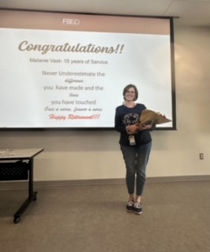
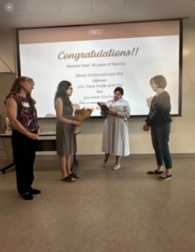
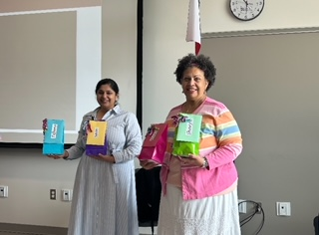
Nurse Appreciation Highlights

Slide 84
Liaison Action Items
Find other liaisons over the summer.
Celebrate Bike To School Day @ your campus.
Work with your Campus Wellness Committee to work on Campus Improvement Plan (CIP) wellness goals over the summer.
Return to SHAC on September 4, 2024. Feel free to bring a guest.

Slide 85
Breakout Discussion

Slide 86
FORT BEND ISD
16431 Lexington Blvd.
Sugar Land, TX 77479
281-634-1000
www.fortbendisd.com

